Slide 1
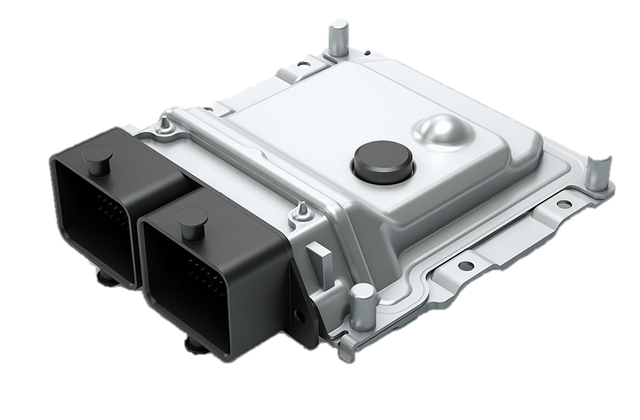
VPC

Slide 2
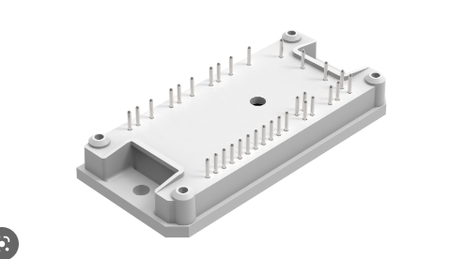
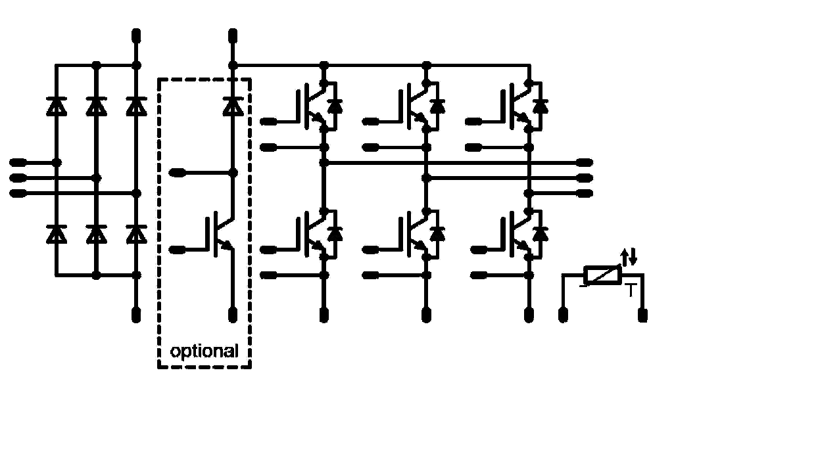

Slide 3
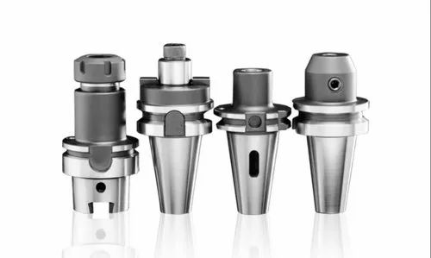

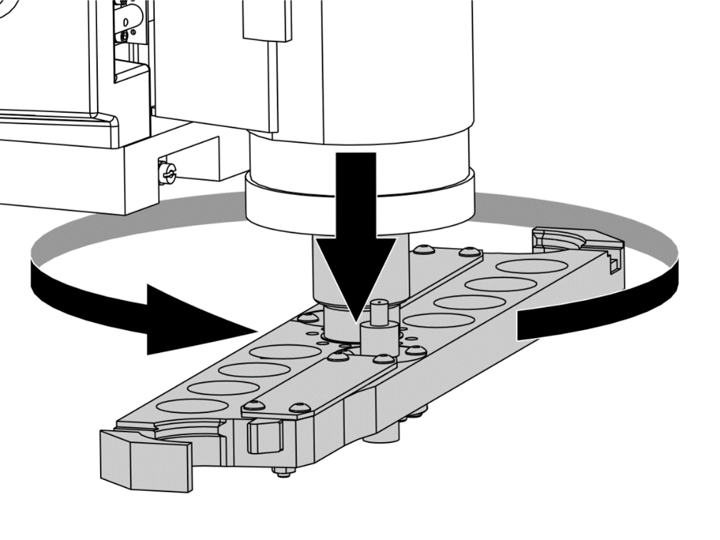

Slide 4

BSW
Global Variable

Slide 5
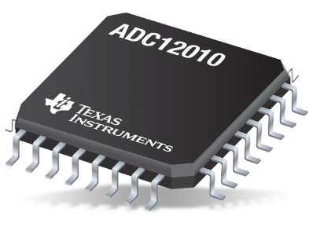
ADC
L02_ADC_READ

Slide 6
ADC
L02_ADC_READ

Slide 7
BSW
B01_OSnScheduler

Slide 8
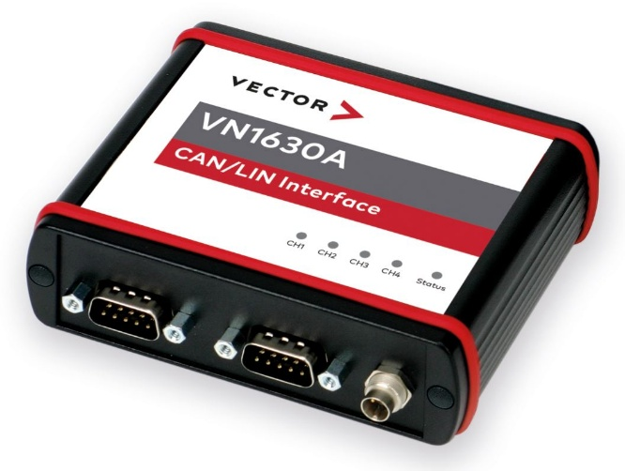
CAN
D01_DRV_CAN

Slide 9
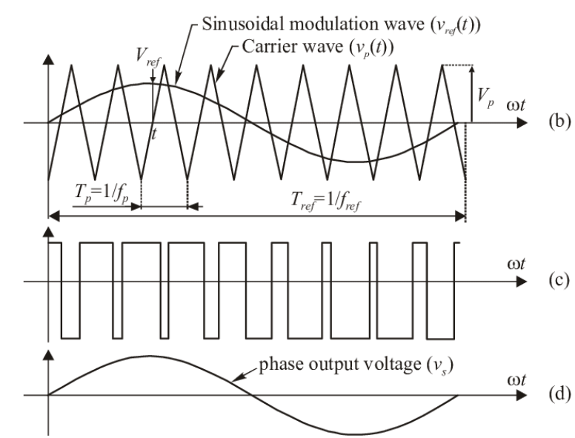
PWM
ePWM

Slide 10
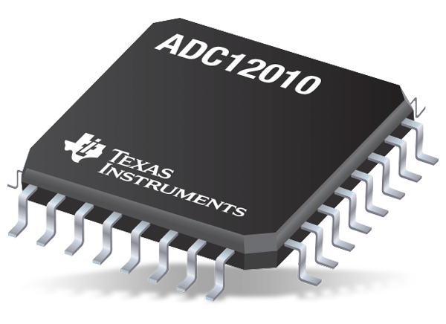
PWM
ePWM

Slide 11
BSW
interrupt

Slide 12
LIN RX
Global Variable

Slide 13
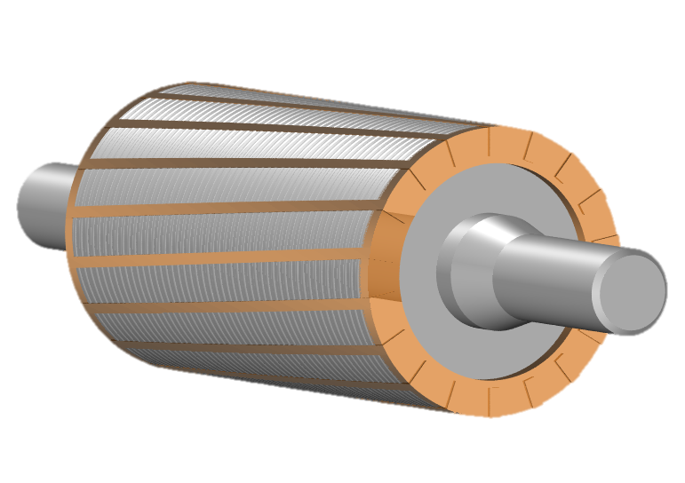
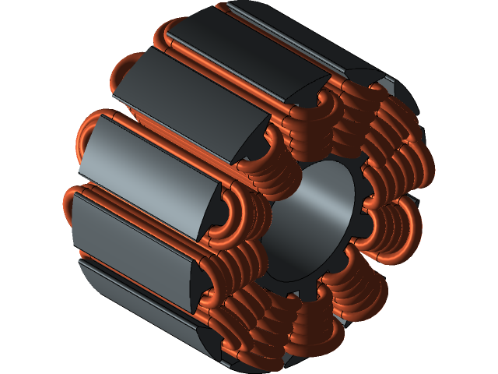

Slide 14

Application
S/W
DESIGN
ANALYSIS
MODEL IN THE LOOP
Turret

Slide 15


Software
DESIGN
ANALYSIS
MODEL IN THE LOOP
-asdfasdfas

Slide 16

eCompressor

Slide 17

MIL Testing

Slide 18


Slide 19
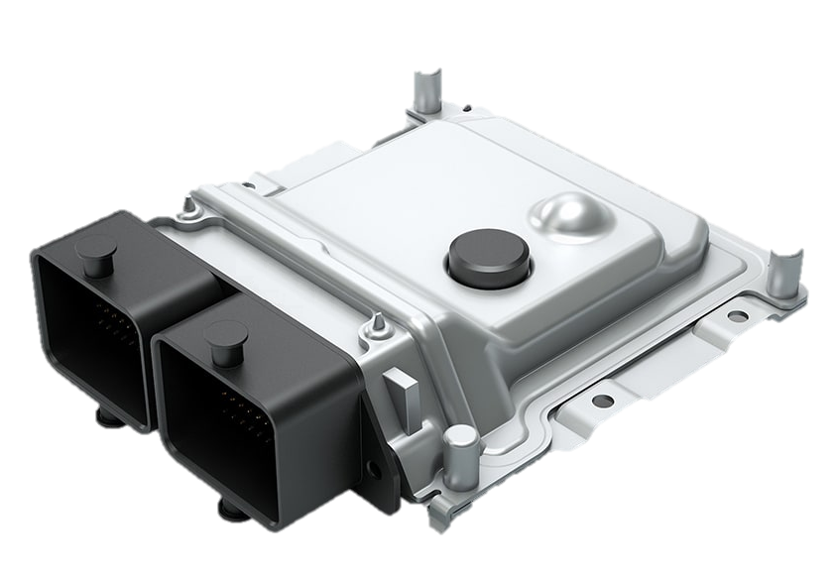
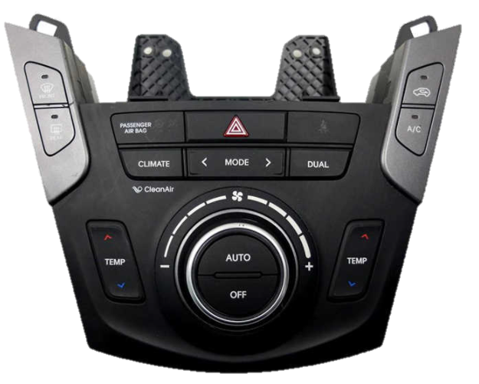
Climate
Control
Air Temperature
Control Unit

Slide 20

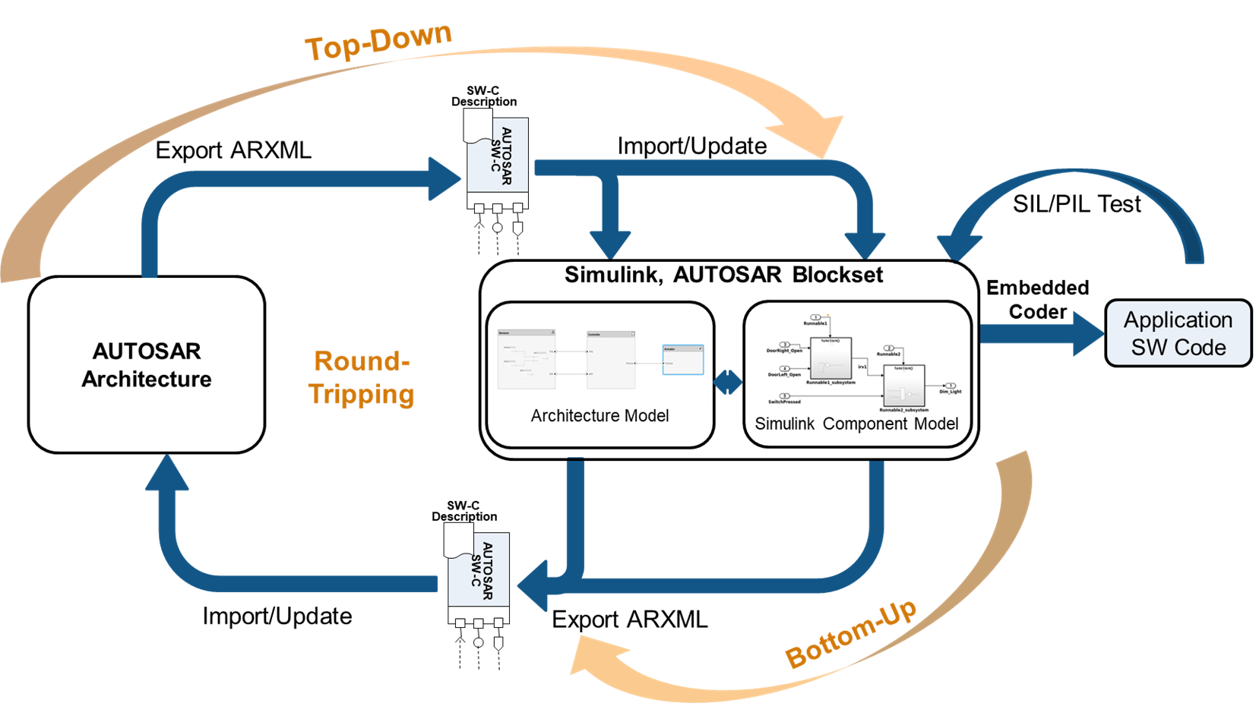

Slide 22


Slide 23


